Slide 1
TRAVELING SALESMAN PROBLEM
Course – CSE246
Instructor – Tanni Mittra
Senior Lecturer
Dept. of CSE
Presented by –
Nadim Srabon (2023-1-60-047)
Sihab Bin Sarwar (2023-1-60-043)
v

Slide 2







PROBLEM!!
A DELIVERY PERSON NEEDS TO DELIVER PACKAGES TO SEVERAL LOCATIONS IN A CITY. THEY WANT TO MINIMIZE THE TOTAL TRAVEL TIME BY DETERMINING THE MOST EFFICIENT ROUTE. THE DELIVERY STARTS AND ENDS AT THE SAME LOCATION, VISITING EACH LOCATION EXACTLY ONCE.
 | 1 | 2 | 3 | 4
Place 1 | 0 | 10 | 15 | 20
Place 2 | 5 | 0 | 9 | 10
Place 3 | 6 | 13 | 0 | 12
Place 4 | 8 | 8 | 9 | 0

Slide 3


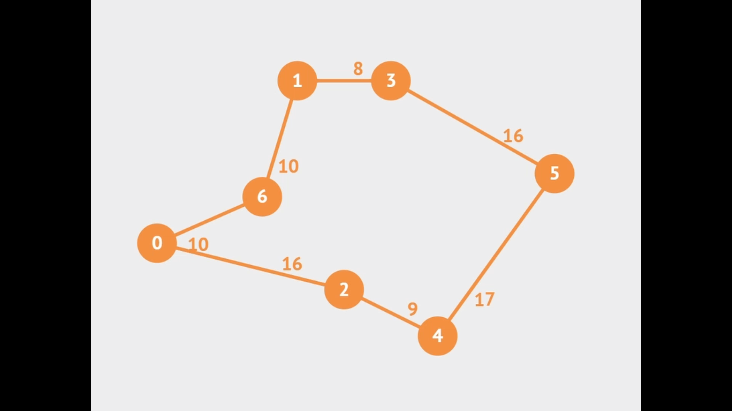
SOLUTION!
THIS PROBLEM IS ONE OF THE TSP PROBLEMS WHICH CAN BE SOLVED BY DIFFERENT APPROCHES LIKE:
GREEDY ALGORITHM (Use for simplicity and speed.)
GRAPH BASED (Best for balancing speed and accuracy in larger instances.)
DYNAMIC PROGRAMMING (Use for exact solutions on small instances.)
Demo Video from VisuAlgo
BUT HERE WE WILL USE DP( HELD – KARP ALGORITHM) BECAUSE IT WILL GIVE US THE MOST OPTIMAL SOLUTION

Slide 4
Brute-Force Calculation!!
}
3
4
2
3
3
4
2
2
3
4
43
2
}
2
40
4
}
4
35
3

Slide 5

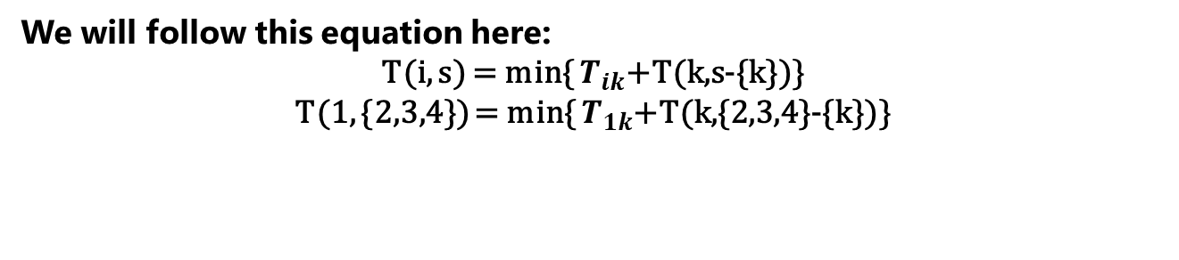


DP- Calculation!!
We will follow this equation here:
T(i, s) = min{ $T_{ik}$+T(k,s-{k})}
T(1, {2,3,4}) = min{ $T_{1k}$+T(k,{2,3,4}-{k})}
1
2
3
4
$T_{12}$+T(2,{3,4})
$T_{13}$+T(3,{2,4})
$T_{14}$+T(4,{2,3})

Slide 6















DP- Calculation!!
1
2
3
4
$T_{12}$+T(2,{3,4})
$T_{13}$+T(3,{2,4})
$T_{14}$+T(4,{2,3})
2
3
4
3
2
4
4
2
3
$T_{23}$+T(3,{4})
$T_{32}$+T(2,{4})
$T_{34}$+T(4,{2})
$T_{42}$+T(2,{3})
$T_{43}$+T(3,{2})
$T_{24}$+T(4,{3})
3
4
4
3
2
4
4
2
2
3
3
2
$T_{34}$+T(4,Ø)
$T_{43}$+T(3,Ø)
$T_{24}$+T(4,Ø)
$T_{42}$+T(2,Ø)
$T_{23}$+T(3,Ø)
$T_{32}$+T(2,Ø)

Slide 7

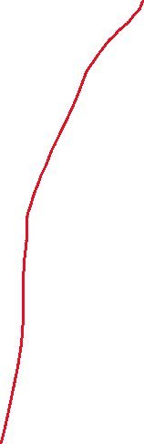

DP- Calculation!!
 | 1 | 2 | 3 | 4
Place 1 | 0 | 10 | 15 | 20
Place 2 | 5 | 0 | 9 | 10
Place 3 | 6 | 13 | 0 | 12
Place 4 | 8 | 8 | 9 | 0
40
1
2
3
4
35
43
10+ min(29,25)
$15$+min (31,25)
20+min(23,27)
2
3
4
3
2
4
4
2
3
9+20
10+15
13+18
12+13
8+15
9+18
3
4
4
3
2
4
4
2
2
3
3
2
12+ 8
9+ 6
10+8
8+5
9+6
13+6

Slide 8
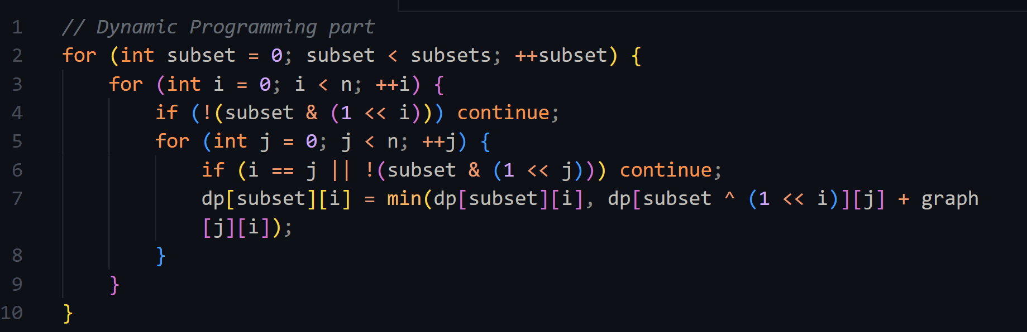
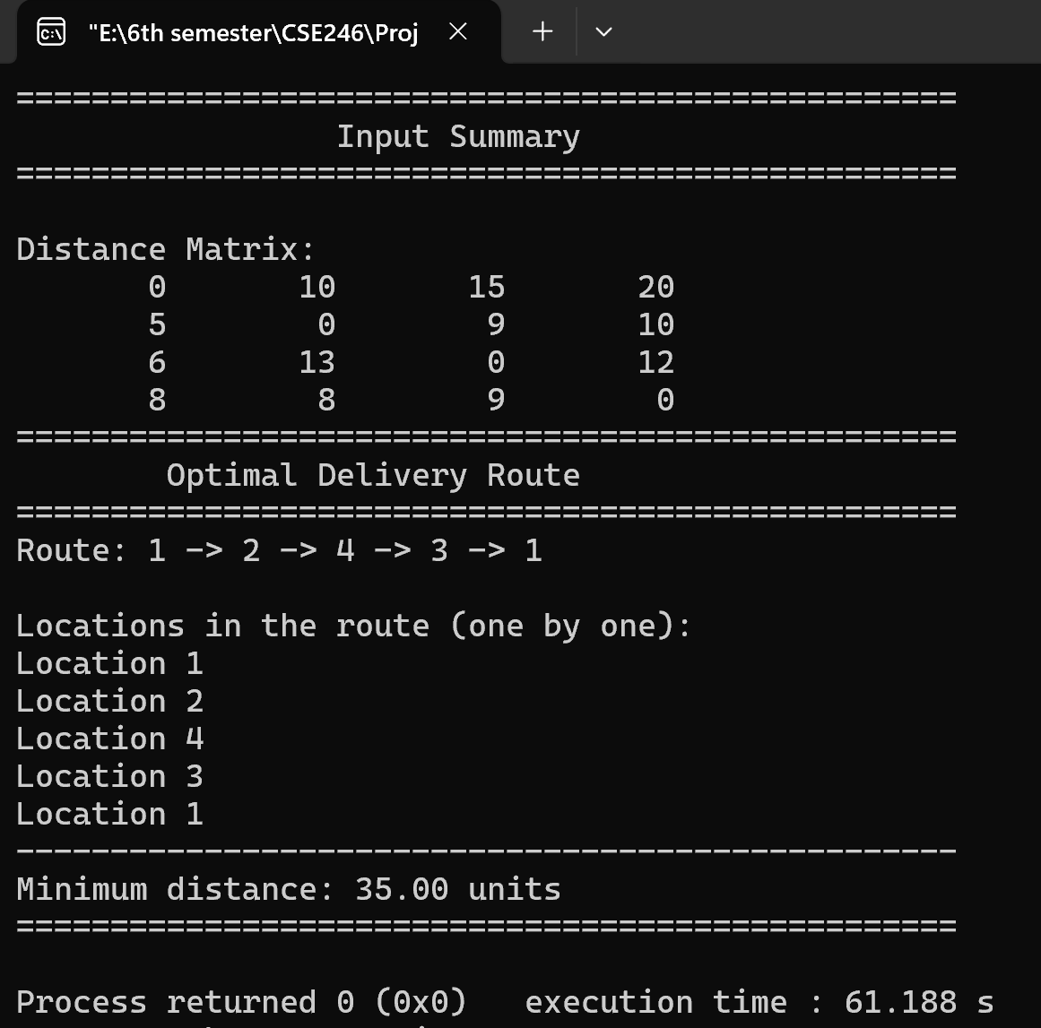
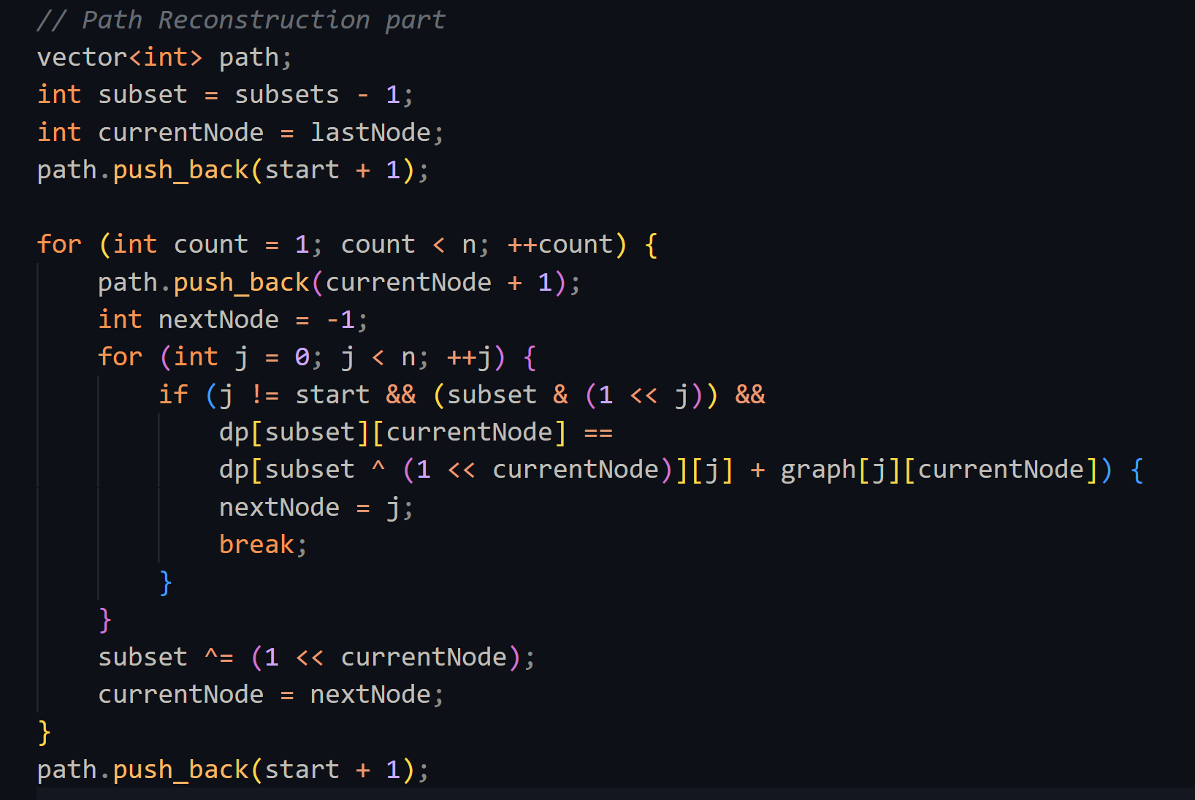
The Code!!
Output

Slide 9

Time Complexity- Calculation!!
Subset
$2^{n}$ Subsets.
𝟐^𝒏 Subsets.
Location
n locations for each subset.
Transition
n possible transitions
Time Complexity = O${(2}^{n}. n.n)=O(n^{2}.2^{n})$

Slide 10
FUTURE SCOPE!!
Perfect!
Real-time Traffic Integration: This is highly relevant for delivery optimization.
Time Windows: Incorporating time windows (delivery deadlines) is crucial for realistic delivery scheduling.
Heuristic Approaches: Investigate heuristic or metaheuristic algorithms (e.g., genetic algorithms, simulated annealing) to handle larger problem instances where dynamic programming becomes computationally infeasible.
User Interface (UI) Development: Create a user-friendly interface for inputting delivery locations, viewing optimized routes, and managing delivery schedules.

Slide 11

Thank You

